Slide 1
Design And Analysis Of Algorithms-Assignment 4
GROUP 2:
ADITYA RAJ IIT2017005
MAYANK MRINAL IIT2017006
MOHIT PAHUJA IIT2017007
ARASHPREET SINGH IIT2017008

Slide 2
PROBLEM
Find an optimal way if you can reach a given number x from 0 when you move i steps in every ith step.

Slide 3
INTRODUCTION
➔ In this problem we have to ﬁnd an optimal way to reach at point x from 0 by moving i distance in ith step. For example 3 takes 2 steps (0, 1) (1, 3) and 4 takes 3 steps (0, -1), (-1, 1) (1, 4). So we are ﬁnding both minimum number of moves and the path. For this we have design only one algorithm.

Slide 4
1. Idea is to move in one direction as long as possible, this will give minimum moves. Starting at 0 ﬁrst move takes us to 1, second move takes us to 3 (1+2) position, third move takes us to 6 (1+2+3) position, ans so on; So for ﬁnding target we keep on adding moves until we ﬁnd the nth move such that 1+2+3+...+n>=target. Now if sum (1+2+3+...+n) is equal to target the our job is done, i.e we’ll need n moves to reach target. Now next case where sum is greater than target. 2. Find the difference by how much we are ahead, i.e sum – target. Let the difference be d = sum – target. 3. If we take the i-th move backward then the new sum will become (sum – 2i), i.e 1+2+3+...-x+x+1...+n. Now if sum-2i = target then our job is done. Since, sum – target = 2i, i.e difference should be even as we will get an integer i ﬂipping which will give the answer. So following cases arise.
ALGORITHM 1

Slide 5
Case1 : Difference is even then answer is n, (because we will always get a move ﬂipping which will lead to target). Case2 : Difference is odd, then we take one more step, i.e add n+1 to sum and now again take the difference. If difference is even the n+1 is the answer else we would have to take one more move and this will certainly make the difference even then answer will be n+2. Explanation : Since difference is odd. Target is either odd or even. case 1: n is even (1+2+3+...+n) then adding n+1 makes the difference even. case 2: n is odd then adding n+1 doesn’t makes difference even so we would have to take one more move, so n+2.
ALGORITHM 1
(Cont.)

Slide 6
PSEUDOCODE

Slide 7
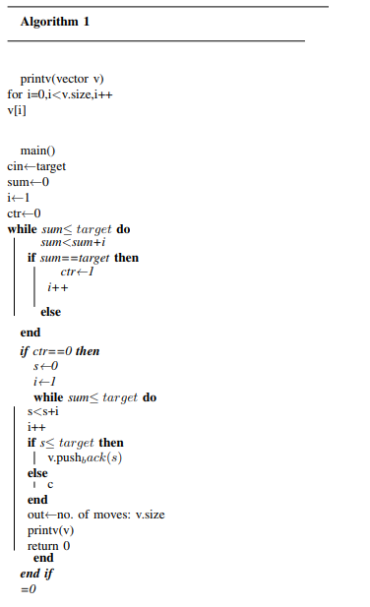

Slide 8
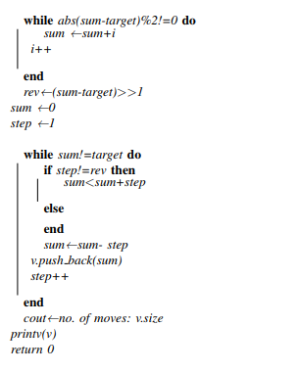

Slide 9
ALGORITHM ANALYSIS
TIME COMPLEXITY
• We have calculated the time consumed in each step in terms of number of computations , as given in the above pseudo code.
• Thus for general value of x let say n , the time complexity is going to be in order of 2n.
• The best case , worst case and average case time complexity will be same i.e. O(n).

Slide 10
SPACE COMPLEXITY
• Since the number of memory location depends on the the variable x since we are storing the path in vector. In worst case the size of the requirement will x O(x).

Slide 11
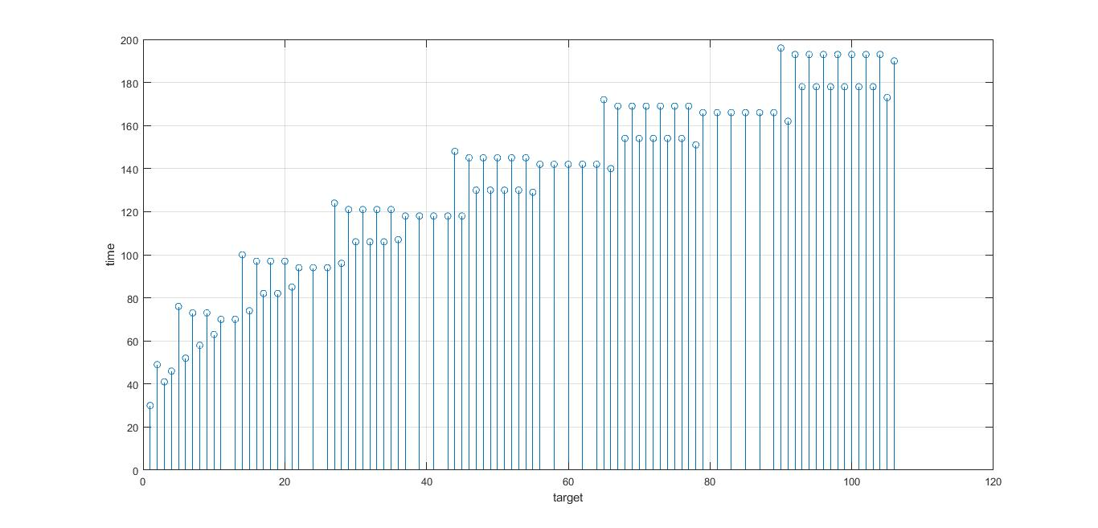
TIME COMPLEXITY
GRAPH

Slide 12
1. The graph depicts that the plot between the target i.e. n and time which comes out to be approximately in the order of 2n. 2. The integrated Development environment of C++ is used for processing the algorithm and graphical analysis is done using MATLAB stem function.
EXPERIMENTAL STUDIES

Slide 13
CONCLUSION
In this document we conclude that our algorithm has a polynomial time complexity with order of 2n for all the cases i.e. best , worst and average case . The space complexity is also of the order n( where n is the size of target number.) Therefore both time and space complexity is O(n).

Slide 14
REFERENCES
1. https://www.geeksforgeeks.org/find-minimum-moves-reach-target-infinite-line/
2.[CLR96] Thomas H. Cormen, Charles E. Leiserson, and
Ronald L Rivest. Introduction to algorithms. The MIT press,
2nd edition, 1996.
3.[DW96] Nell Dale and Henry M. Walker. Abstract data
types: specifications, implementations, and applications. D.
C. Heath and Company, Lexington, MA, USA, 1996.

Slide 15
THANK YOU

